Slide 1

OPERATING SYSTEMS
Memory Management

Slide 2
Demand Paging
A demand paging system is quite similar to a paging system with swapping where processes reside in secondary memory and pages are loaded only on demand, not in advance.
When a context switch occurs, the operating system does not copy any of the old program’s pages out to the disk or any of the new program’s pages into the main memory.
Instead, it just begins executing the new program after loading the first page and fetches that program’s pages as they are referenced.

Slide 3
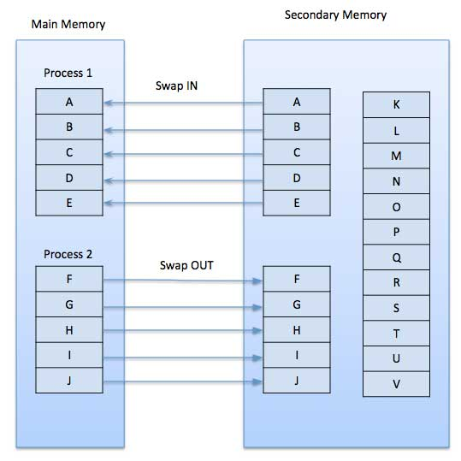
https://www.tutorialspoint.com/operating_system/os_virtual_memory.htm

Slide 4
Page Fault
While executing a program, if the program references a page which is not available in the main memory.
Processor treats this invalid memory reference as a page fault and transfers control from the program to the operating system to demand the page back into the memory.

Slide 5
Advantages
Large virtual memory.
More efficient use of memory.
There is no limit on degree of multiprogramming.

Slide 6
Disadvantages
Number of tables and the amount of processor overhead for handling page interrupts are greater than in the case of the simple paged management techniques.

Slide 7
Paging Revisitted
If a page is not in physical memory
  find the page on disk
  find a free frame
  bring the page into memory
What if there is no free frame in memory?

Slide 8
Page Replacement
Basic idea
  if there is a free page in memory, use it
  if not, select a victim frame
  write the victim out to disk
  read the desired page into the now free frame
  update page tables
  restart the process

Slide 9
Page Replacement
Main objective of a good replacement algorithm is to achieve a low page fault rate
  insure that heavily used pages stay in memory
  the replaced page should not be needed for some time
Secondary objective is to reduce latency of a page fault
  efficient code
  replace pages that do not need to be written out

Slide 10
Reference String
Reference string is the sequence of pages being referenced
If user has the following sequence of addresses
  123, 215, 600, 1234, 76, 96
If the page size is 100, then the reference string is
  1, 2, 6, 12, 0, 0

Slide 11
First In First Out (FIFO) algorithm
Oldest page in main memory is the one which will be selected for replacement.
Very simple to implement
  keep a list
    victims are chosen from the tail
    new pages in are placed at the head

Slide 12
FIFO
Page Fault Rate = 9 / 12 = 0.75
Consider the following reference string: 0, 2, 1, 6, 4, 0, 1, 0, 3, 1, 2, 1
    x x x x x x x x x
Compulsory Misses
0
0
0
0
2
2
1
2
1
0
4
4
4
4
2
6
2
4
2
0
0
3
0
1
0
2
0
1
1
1
3
3
3
6
6
6
6
1
1

Slide 13
FIFO Issues
Poor replacement policy
Evicts the oldest page in the system
  usually a heavily used variable should be around for a long time
  FIFO replaces the oldest page - perhaps the one with the heavily used variable
FIFO does not consider page usage

Slide 14
Giving more memory to process would improve its performance?
Consider the following reference string:
1, 2, 3, 4, 1, 2, 5, 1, 2, 3, 4, 5
Calculate the page fault rate for 3 frames and 4 frames with FIFO page replacement algorithm.

Slide 15
Belady’s Anomaly:
For some page replacement algorithms, the page fault rate may increase as the number of allocated frames increases.

Slide 16
Optimal Page Replacement
Basic idea
  replace the page that will not be referenced for the longest time
This gives the lowest possible fault rate

Slide 17
Optimal Page Replacement(Future)
Consider the following reference string: 0, 2, 1, 6, 4, 0, 1, 0, 3, 1, 2, 1
    x x x x x x
Compulsory Misses
0
0
0
0
0
3
0
2
2
2
6
2
4
2
3
2
1
1
1
1
1
6
4
4
Fault Rate = 6 / 12 = 0.50
With the above reference string, this is the best we can hope to do

Slide 18
Least Recently Used (LRU)(Past)
Basic idea
  replace the page in memory that has not been accessed for the longest time
Optimal policy looking back in time
  as opposed to forward in time
  fortunately, programs tend to follow similar behavior

Slide 19
LRU
Consider the following reference string: 0, 2, 1, 6, 4, 0, 1, 0, 3, 1, 2, 1
    x x x x x x x x
Compulsory Misses
Fault Rate = 8 / 12 = 0.67
0
0
0
0
2
2
2
6
1
1
0
4
4
4
2
2
4
2
0
0
3
0
2
0
1
1
1
1
1
6
6
6
3
3

Slide 20
LRU Issues
How to keep track of last page access?
  requires special hardware support
2 major solutions
  Counters
    the page with the smallest “time” value is replaced
  stack
    keep a stack of references
    on every reference to a page, move it to top of stack
    page at bottom of stack is next one to be replaced

Slide 21
Q1
Find the page fault rate by considering the following reference string:
7,0,1,2,0,3,0,4,2,3,0,3,2,1,2,0,1,7,0,1 using three frames with
(i) FIFO
(ii) Optimal
(iii) LRU
(i)15
(ii) 9
(iii) 12

Slide 22
Q2
Consider the following page reference string: 1,2,3,4,2,1,5,6,2,1,2,3,7,6,3,2,1,2,3,6
How many page faults would occur for replacement by LRU, FIFO, optimal, for one, two, three, four, five, six and seven frames? All frames are initially empty and first unique page reference causes a page fault.
# frames 1 2 3 4 5 6 7
LRU 20 18 15 10 8 7 7
FIFO 20 18 16 14 10 10 7
Optimal 20 15 11 8 7 7 7

Slide 23
In a demand-paged system, the degree of multiprogramming is fixed at 4. Measurements were made to determine the utilization of cpu and the paging disk. The result is one of the following. For each of case a, b, c, state in one line what is happening?
a. cpu utilization 13%, disk 97%
b. cpu utilization 92%, disk 11%
c. cpu utilization 21%, disk 3%
Answer:
a. Thrashing
b. okay
c. can increase multiprogramming

Slide 24
In which one of the following page replacement algorithms it is possible for the page fault rate to increase even when the number of allocated frames increases?
(A) LRU (Least Recently Used)
(B) OPT (Optimal Page Replacement)
(C) MRU (Most Recently Used)
(D) FIFO (First In First Out)
Ans: D

